Slide 1
18752 Project: Predicting future traffic patterns using GPS trajectories
Eric Yang and Yasser Corzo

Slide 2
Outline [hidden slide and only for reference]
Problem statement (1 slide)
Data collection and pre-processing (up to 2 slides)
Feature extraction (3 slides)
― Including Data visualization (1 slide)
Regression/classification/time series prediction (4 slides)
―One of these methods should meet the performance specification
Picture of the software code (up to 2 slides)
―Explain each section of the code
Slides explaining methods that are unfamiliar to the class (up to 4 slides)
because they were not taught in the lectures
You can also include additional slides if they help explain the project better

Slide 3
Problem Statement
Predicting traffic time accurately is crucial for tasks such as urban planning and navigation systems. Using Microsoft’s Geolife GPS trajectory dataset, we hope to develop a robust model for predicting traffic time (in China) based on historical movement patterns from the 182 users in the dataset.

Slide 4
Data Collection and Preprocessing
Dataset: Geolife GPS trajectory dataset
Trajectories of 182 users from April 2007 to August 2012 (user’s respected trajectories are matched).
17,621 trajectories with a total distance of 1,292,951 km and a total duration of 50,176 hrs
Sampling rate: every 1~5 seconds or every 5~10 meters per point.
Mainly from 30 cities in China, some in the US and Europe.
Each trajectory is stored in a PLT file with fields:
Latitude in decimal degrees
Longitude in decimal degrees
Altitude in feet
Date - number of days (with fractional part) that have passed since 12/30/1899
Date as a string
Time as a string (in GMT format)
Notes:
The dataset that we are using to train our predictive model is the Geolife GPS trajectory dataset developed by Microsoft Research Asia. The data of the GPS trajectories (or paths) is represented by 24,876,978 points recorded by 182 users in the period from April 2007 to August 2012. Each folder of the dataset contains the file of the GPS trajectories, in PLT format, of a single user. Each PLT file contains a single trajectory and contains the following fields: latitude and longitude in decimal degrees, altitude in feet, date in terms of the number of days that have passed since Dec 30 1899, date as a string and time as a string in GMT format.
This dataset recorded a broad range of users’ outdoor movements, including not only life routines like go home and go to work but also some entertainments and sports activities, such as shopping, sightseeing, dining, hiking, and cycling. Although this dataset is widely distributed in over 30 cities of China and even in some cities located in the USA and Europe, the majority of the data was created in Beijing, China

Slide 5
Data Collection and Preprocessing (cont)
73 users have labeled their trajectories in a labels file with start and end time, transportation mode.
Data Preprocessing:
Filter users who have a label file and who have car as trajectories labels.
Process these time ranges and match them with the corresponding PLT files.
Filter out trajectories that weren’t recorded in China.
Calculate average latitude, longitude, altitude, and speed; total distance and total time
Pair these values with the userid onto a csv file: 734 trajectories
Notes:
It’s important to note that 73 users have labeled their trajectories with transportation mode, such as driving, taking a bus, riding a bike and walking. There is a label file storing the transportation mode labels in each user’s folder.
Since our goal is to predict traffic time in China via driving a car, we filtered users who first have their trajectories labeled in a label file AND whose trajectories are labeled with car. Since the structure of the labels file includes a start and end time (representing the start and end time of the recording), we process these time ranges and match them with the corresponding PLT trajectory files that also contain a time field. We filter out trajectories that weren’t recorded in China. Now our filtered trajectory dataset contains only car trajectories in China. We then calculate the average latitude, longitude, altitude and speed, as well as the total distance and total time of the trajectory. We pair these values with the user who recorded these trajectories and put it all into a csv file where we are left with 734 trajectories.

Slide 6
Feature extraction
Automatic Feature Extraction
PCA
Dimensionality reduction technique
Transforms the original variables into uncorrelated variables called principal components
Directions of maximum variance in the dataset
Linear combinations of the original variables
K-means
Idea: group points similar to each other in clusters.
Instead of data points, features are clustered.
features that are assigned to the same cluster are considered to have similar patterns.
select features based on their cluster membership.
Notes:
The two methods of automatic feature extraction we used are PCA and K-means clustering.
PCA is used to reduce the dimensionality of the feature space. The motivation behind the algorithm is that there are certain features that capture a large percentage of variance in the original dataset. So it’s important to find the directions of maximum variance in the dataset. These directions are called principal components, which are linear combinations of the original variables.
K-means is used for partitioning a dataset into a set of clusters. The goal of K-means is to group data points into clusters such that points within the same cluster are more similar to each other than they are to points in other clusters.K-means clustering can be used in feature selection by exploiting the notion that relevant features tend to exhibit similar patterns within clusters, while irrelevant features may exhibit more random or dissimilar patterns. Instead of clustering data points, we cluster features. Each feature is treated as a data point in a high-dimensional space, and K-means is applied to cluster these features based on their similarities. After clustering features, each feature is assigned to a cluster based on its similarity to the cluster centroids. Features that are assigned to the same cluster are considered to have similar patterns and may be more relevant to the problem being addressed.

Slide 7
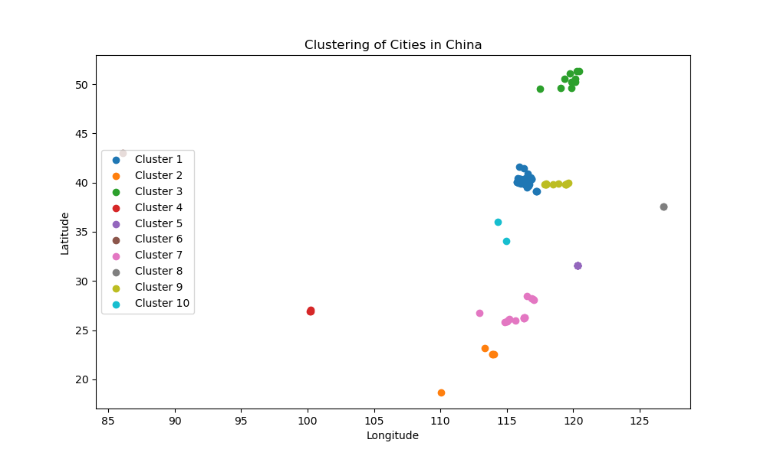
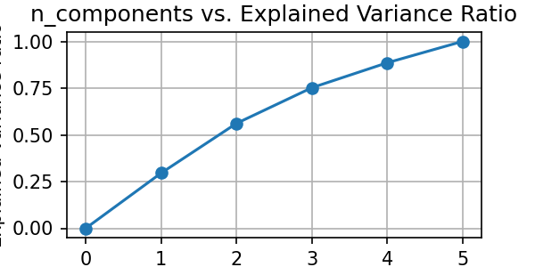
Data Visualization For PCA and K-means
Notes:
The figure on the right was used to help choose the optimal number of components for the PCA algorithm. The x-axis represents the number of components while the y axis represents the explained variance ratio. As practice, we want to choose the number of components such that we’ll be able to capture more than 80% of the variance in the dataset. As a result, the optimal number of components is 4.

Slide 8
Manual Feature Extraction
Within each user’s trajectory file, manually extracted the following features and label for final prediction and inference task (shown in code examples):
Features
Average latitude
Average longitude
Average altitude
Total distance (using Python’s geopy package, shown in new methods later)
Average speed
Label / regression values
Total travel time

Slide 9
Inference
Prediction using 4 regression methods
Linear statistical regression
Support vector regression (SVR)
Random forests (ensemble learning of decision trees)
Deep neural networks
Reasons for choosing each model and statistical method
Regression normalized MSE (NMSE) metric
MSE scaled by variance of y_test
Achieved threshold of < 10% for 2 out of 4 models

Slide 10
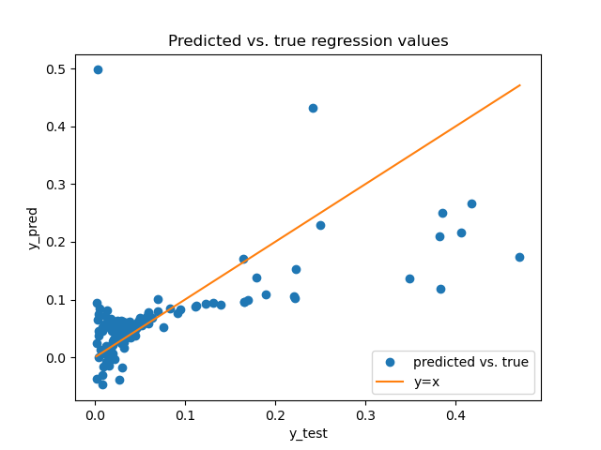
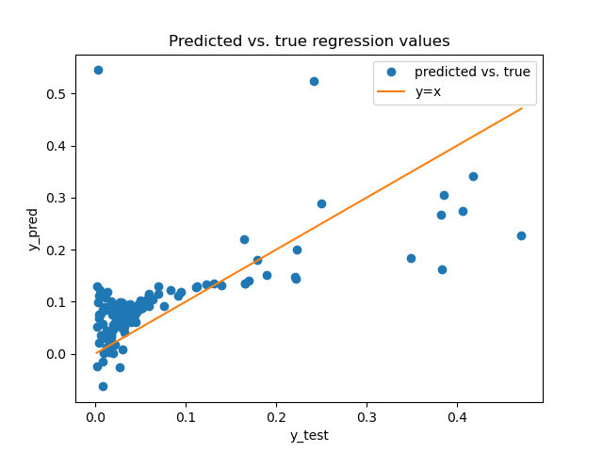
Results + Plots Discussion
Linear regression
Support vector regression

Slide 11
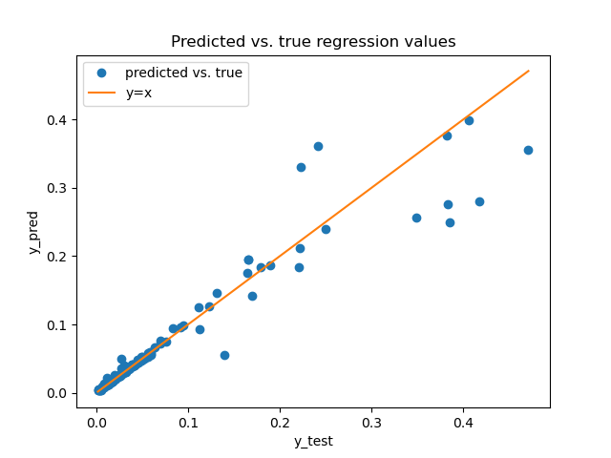
Results: Random Forests

Slide 12
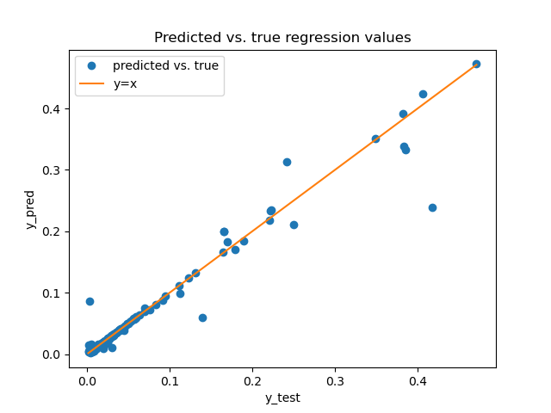
Results: Deep Neural Networks
Model architecture
4 linear / fully connected layers followed by ReLU activation functions
Training parameters:
MSE loss
Adam optimizer with learning rate of 0.01
100 epochs
Batch size 128

Slide 13
Regression NMSE metric
Model | Linear regression | Support vector regression | Random forests | Deep neural networks
NMSE | 60.735% | 71.019% | 8.978% | 5.021%

Slide 14
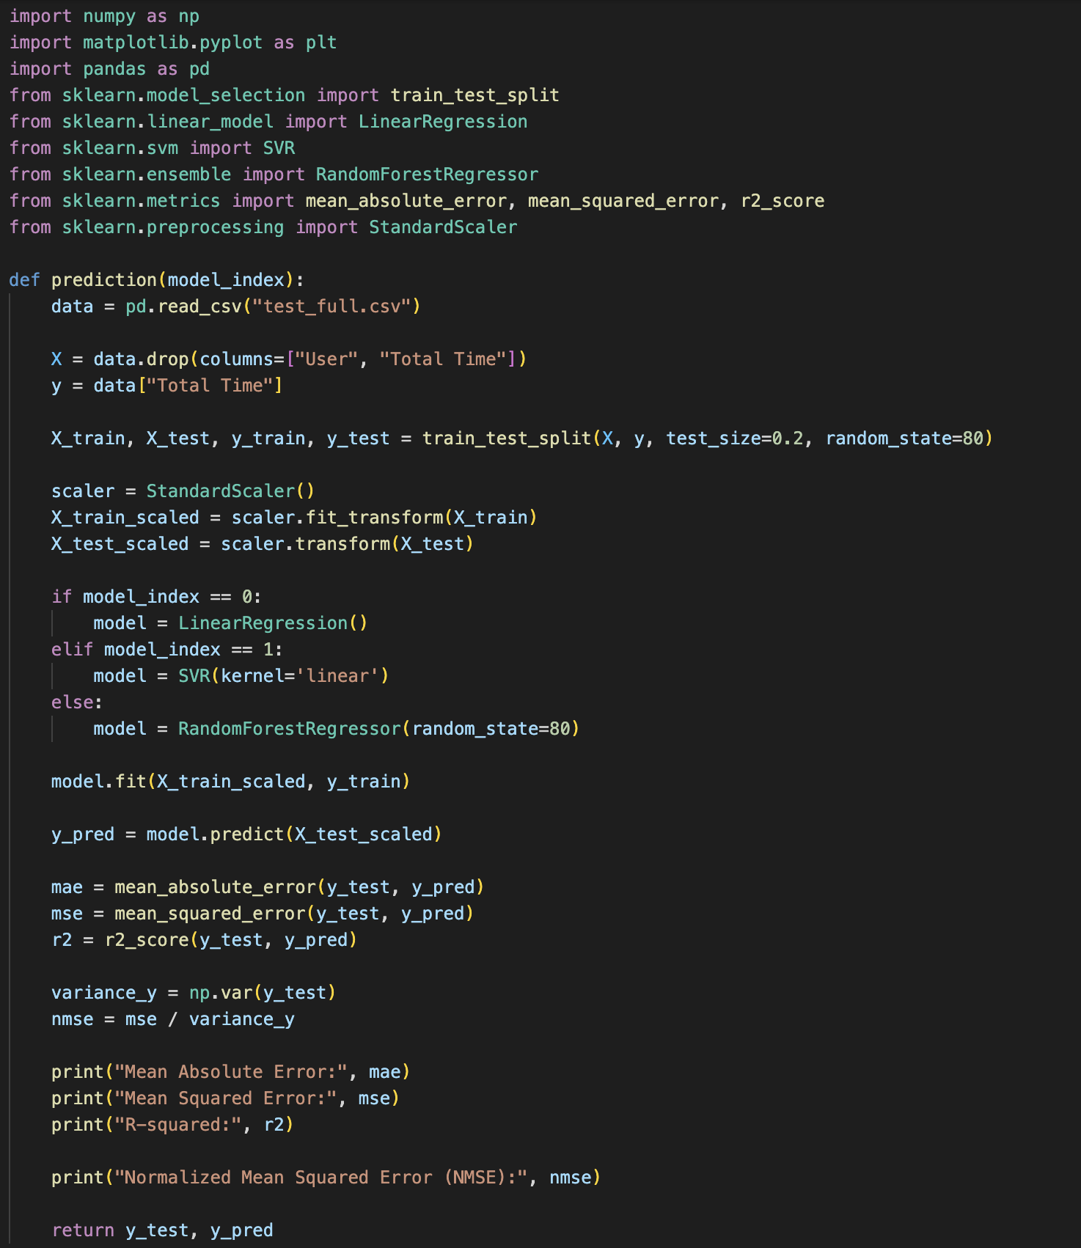
Code Examples (sklearn)

Slide 15
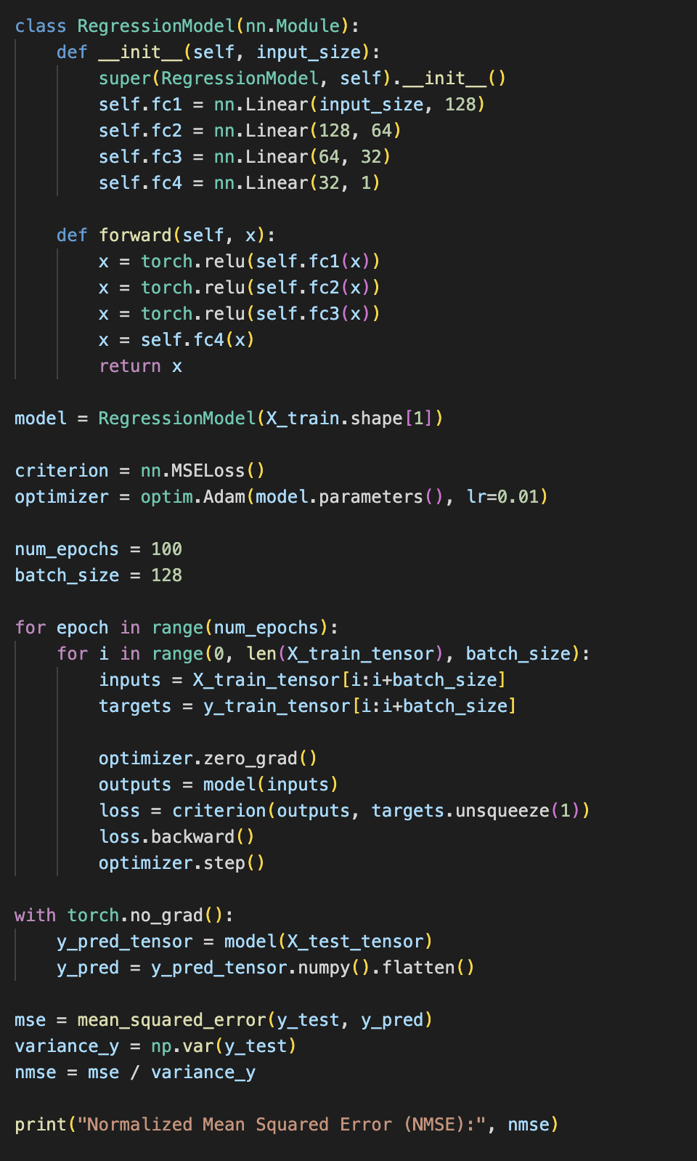
Code Examples (PyTorch)

Slide 16
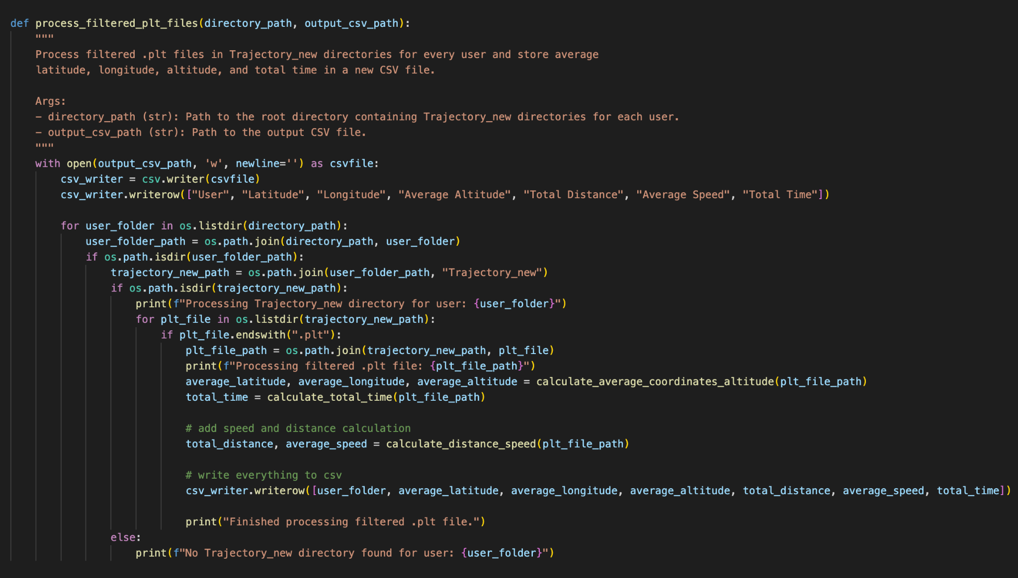
New Methods

Slide 17
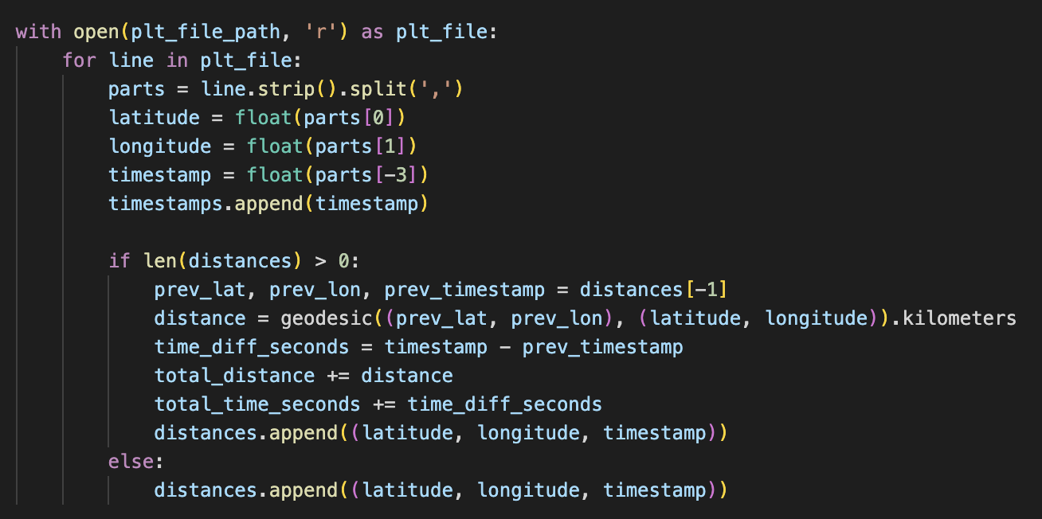
New Methods (continued)

Slide 18
Conclusion / Future Work
Motivation: really important to understand impacts on traffic and congestion on travel times and GPS studies
Achieved low MSE prediction error with random forests and deep neural networks
Experiment with results and regression normalized MSE using other models
Bayesian learning
State estimation using Kalman filters or extended Kalman filters (EKF)
Model the bias-variance tradeoff to better understand the effects of underfitting or overfitting of data
Visually
Mathematically

Slide 19
References
Microsoft’s GeoLife GPS Trajectories dataset
https://dl.acm.org/doi/10.1145/3277868.3277870
Python documentation
NumPy, pandas, matplotlib
Geopy
Sklearn
PyTorch

